Slide 1
Reprocessing of Reusable Medical Equipment Between Each Resident or When Soiled
Nursing
Notes:
Let’s do a brief review of the important factors related to cleaning and disinfecting the environment and resident care equipment.
It is important to remember that everyone on staff is responsible for maintaining a safe, clean environment for the protection of everyone in the facility.
While our EVS staff is primarily responsible for the cleaning of the environment, nursing is expected to clean surfaces and resident care equipment that become soiled or contaminated using the appropriate products.

Slide 2
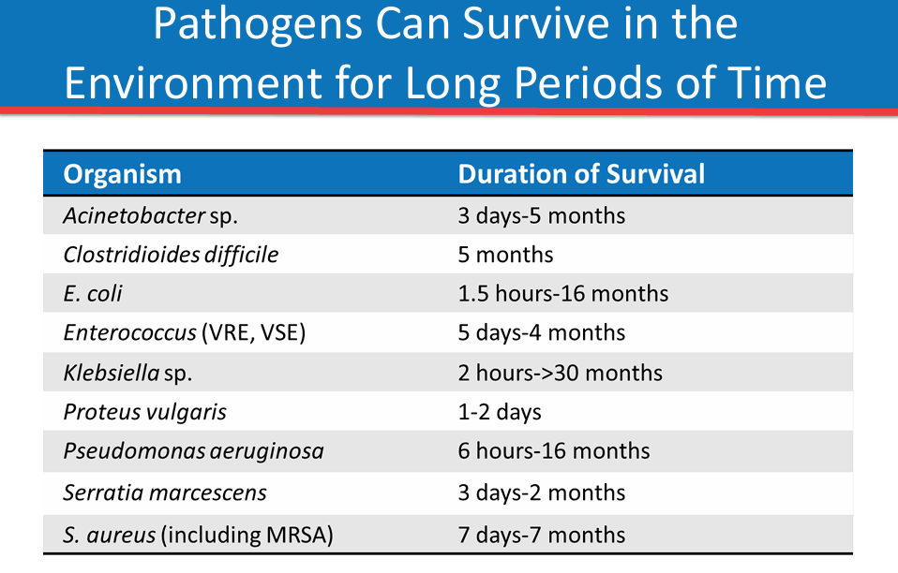
Notes:
Pathogens contaminate medical equipment and devices, and they can survive for very long periods of time in the absence of effective cleaning and disinfection processes.
Most of us have probably heard that C. diff spores can survive in the environment for months, but it is less commonly known how long many other pathogens can survive in the environment.
As shown in this table, many of these pathogens, including MRSA and gram-negative organisms such as Acinetobacter and Pseudomonas, are capable of surviving for hours to days to weeks, and even for several months.
This ability to persist in the environment can play a critical role in the transmission of pathogens from resident-to-resident.

Slide 3

Categories of Disinfectants and
Disinfection Process
Low level disinfection kills most vegetative bacteria, some viruses, and some fungi, but cannot be relied upon to kill mycobacteria or bacterial spores.
1
Intermediate level disinfection kills vegetative bacteria, most viruses and most fungi, but does not reliably kill all bacterial spores.
2
They do kill C. diff spores
High level disinfection is a specialized skill performed in certain areas of the facility
3
Notes:
It is important to understand that even within the category of disinfection, there are three subcategories, or levels of disinfection, to be familiar with.
Low level disinfection kills most vegetative bacteria, some viruses, and some fungi, but cannot be relied upon to kill mycobacteria or bacterial spores.
Intermediate level disinfection kills vegetative bacteria, most viruses and most fungi, but does not reliably kill bacterial spores.
High level disinfection, often referred to as HLD, is a specialized skill performed in certain areas of the facility

Slide 4
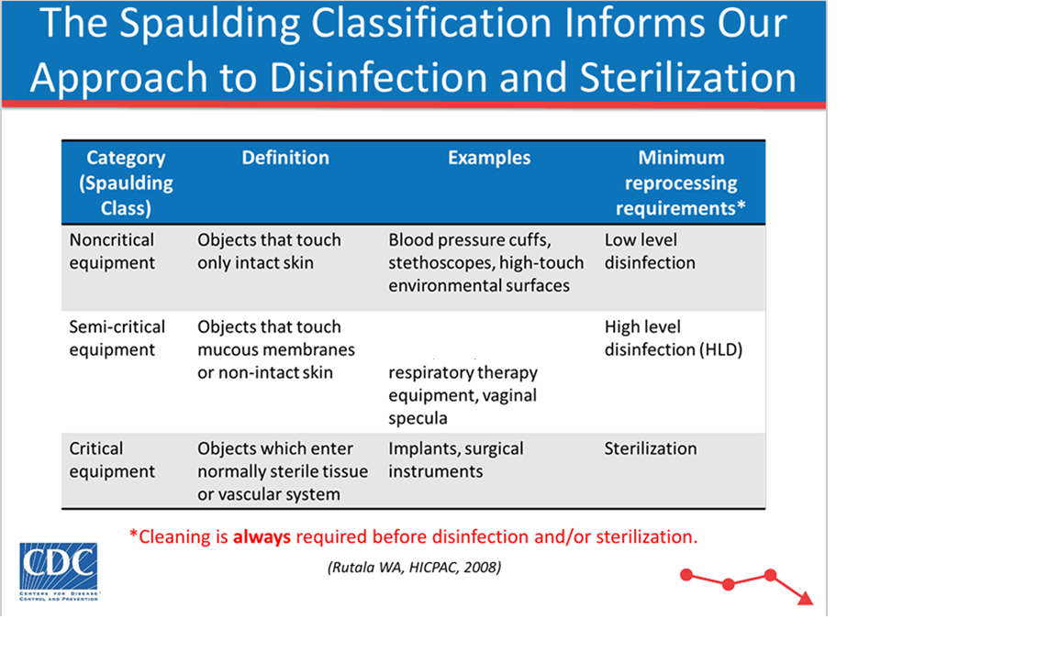
Notes:
The Spaulding classification defines the minimum level of disinfection or sterilization required based on how the item is used or the part of the body with which it makes contact.
Non-critical equipment is that which touches only intact skin. Examples of non-critical equipment include blood pressure cuffs, stethoscopes and environmental surfaces in the resident care environment. Non-critical equipment is reprocessed by cleaning and, at a minimum, low level disinfection.
Semi-critical equipment includes any equipment or item that comes into contact with mucous membranes or non-intact skin. Semi-critical equipment includes respiratory therapy equipment, and vaginal specula. These items must be reprocessed by cleaning and high level disinfection.
Lastly, critical equipment is equipment that enters normally sterile tissue or the vascular system and includes implanted devices and materials and surgical instruments. Critical equipment must be cleaned and sterilized prior to use. In our facility we do not perform any sterilization. We purchase sterile supplies.
An important rule is that cleaning of the surface must always be done before disinfection. Organic matter such as blood and body fluids will inactivate disinfectants.

Slide 5
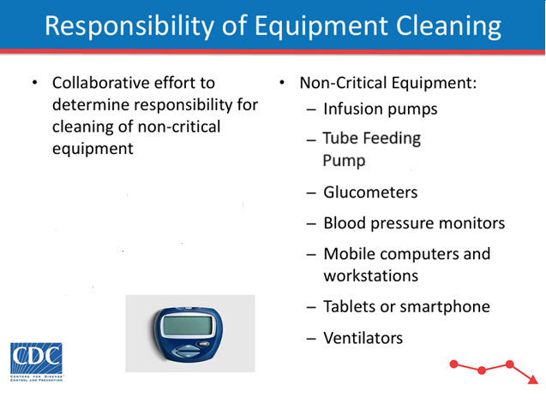
Notes:
When it comes cleaning resident care equipment, Environmental Services and Nursing both have responsibilities.
Clean and reprocess (disinfect) reusable medical equipment (e.g., blood glucose meters and other point-of-care devices, blood pressure cuffs, oximeter probes, transfer leift, etc.) to use on another resident or when soiled.
The facility has a list of what items nursing is responsible for and which items EVS staff are responsible for. This avoids confusion and ensures equipment is cleaned and disinfected between resident use.
The list has the following outlined on it— the equipment name, the standard of cleaning (e.g., after use, when visibly soiled), method of cleaning and type of disinfectant, the group responsible for cleaning and any additional comments.
Instructor: Review the facility’s list to give examples.
Manufacturer’s instructions for cleaning and disinfecting the equipment or device must be followed.
When information from manufacturers is limited regarding selection and use of agents for specific microorganisms, or equipment, facility policies regarding cleaning and disinfecting should be guided by the best available evidence and careful consideration of the risks and benefits of the available options.
Maintain separation between clean and soiled equipment to prevent cross contamination.

Slide 6
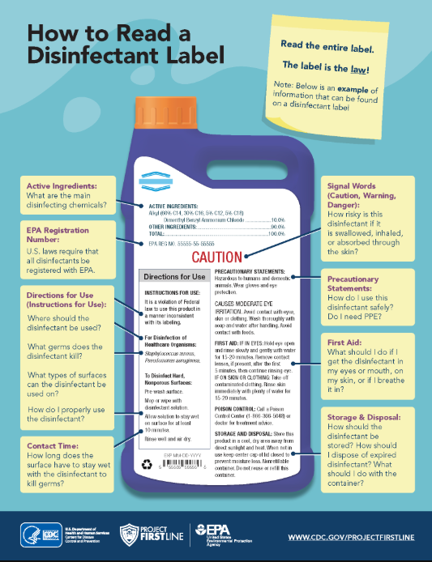
Notes:
The facility has several different types of disinfectants, and it is vital for nurses to know which product to use on the different pieces of equipment and devices and how to properly use them.
Instructor – give example of glucometer used in your facility and which disinfectant should be used and the contact time. Emphasize that using an alcohol wipe is not appropriate to use.
Instructor: Give another example of resident care equipment and what disinfectant to use.
Manufacturers are required by OSHA to properly label disinfectants.
Instructors: review the information on the slide:
Directions for use-including microorganisms the disinfectant will kill
Contact Time
Signal word-caution statements
Precautionary statement – what PPE to wear when using the product
First aid
Storage and Disposal
Chemicals must be securely stored when not in use.
All cleaning supplies should be stored in their original container, and any other containers should be properly labeled.

Slide 7
Resources
CDC's Core Infection Prevention and Control Practices for Safe Healthcare Delivery in All Settings, CDC's Core Infection Prevention and Control Practices for Safe Healthcare Delivery in All Settings | Infection Control | CDC, Accessed 08-19-2025
CDC Environmental Cleaning and Disinfection: Principles of Infection Transmission and the Role of the Environment, https://www.cdc.gov/infection-control/media/pdfs/Strive-EC101-508.pdf Accessed 06-25-2025
CDC Cleaning and Disinfection Strategies for Non-Critical Surfaces and Equipment, https://www.cdc.gov/infection-control/media/pdfs/Strive-EC102-508.pdf Accessed 06-25-2025
EPA How to Read A Disinfectant Label, https://www.epa.gov/system/files/images/2022-09/HowToReadALabel-508c-Final-2022-08-30%20%28005%29_1.png Accessed 06-25-2025

